Slide 1
Release 6
Senior Design
Notes:
Taher

Slide 2
Project Background
Notes:
Taher

Slide 3
Introduction
What is our project?
To design and create a process that allows users to control hardware that captures and provides consistent high quality photos in a 360° view to be saved to Spreetail storage.
Notes:
Taher

Slide 4
Introduction
Why is this project important?
Simplify photography process
Provide consistent high quality photos
Photos will be used on Spreetail.com
Set Spreetail apart from competition through photography
Notes:
Taher

Slide 5
Introduction
How will we accomplish our goals?
Create a user friendly front-end web-application
Using React and Spreetail library components
User can enter product ItemID
View preview image from each camera
Start full 360° image capture
View and select images to be stored
Send selected photos to Spreetail storage
Notes:
Taher

Slide 6
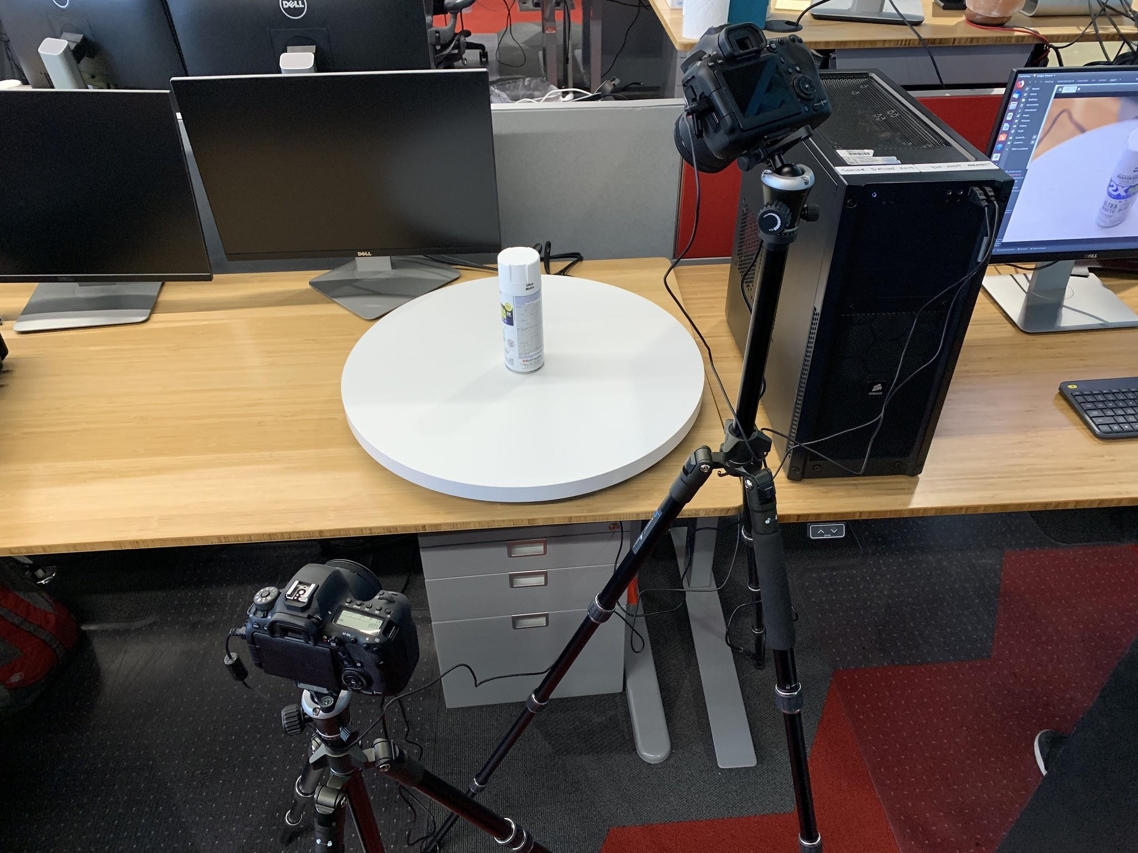
Introduction
How will we accomplish our goals?
Components for hardware setup
Two DSLR Cameras (Canon EOS 6D Mark II)
Two Tripods
Electric Turntable (Spins at ~97 sec/rotation)
Linux tower for camera control
Lighting (Provided by Spreetail, warehouse has lighting setup)
Software to control cameras via Linux tower
Notes:
Li

Slide 7
Introduction
How will we accomplish our goals?
Communication between Web-application and hardware
Azure Message Bus Service
Fast messaging between entities
Decouples application and control tower
Both sides can connect from anywhere
Allow the front end to send commands to the control tower
Provide specific commands to take/retrieve images
Notes:
Li

Slide 8
Progress
Hardware - Last Release
Error Handling
Integration tests
Clearing message queue
Capture change - command for each capture
Established Azure Connection
Notes:
Jared

Slide 9
Progress
Hardware - This Release
Capture changes
Sending while taking
Set interval and duration from front end
Save to Azure Storage
Documentation
Code cleanup and commenting
Script to install libraries & run server application
 | Before Change | After Change
Time | 3’6” (186 seconds) | 1’49” (109 seconds)
Number of Photos | 98 | 140
Notes:
Jared

Slide 10
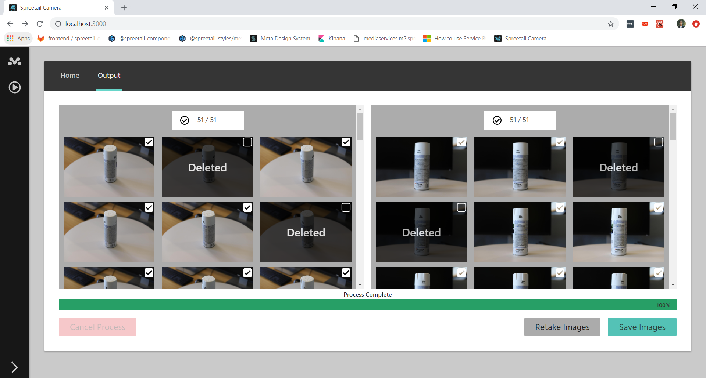
Progress
Front End - Last Release
Output page
Thumbnail view
Larger image view
Progress bar
Image selection
Retake images
Loading spinners
Notes:
Ant

Slide 11
Progress
Front End - This Release
Removed individual progresses
Added confirmation modals
Refactored a lot of components
Preview, Output, Modal
Organized Styles
Added environment variables to control duration and interval
Notes:
Ant

Slide 12
Demo

Slide 13
What’s next?
Showcase (April 24th)
Meeting with Spreetail team for handoff (April 25th)
Final Documentation
Software Documentation
Installation and deployment guide
User Guide
Etc.
Notes:
Jared

Slide 14
Questions?

